Slide 1


Chief’s Report
Enumclaw Fire Department
11-16-2022

Slide 2
Follow up/Information
Commercial space lease is under legal review with Attorney Brian Snure
TCA Station Analysis Kick-Off Meeting set for 12/13 0830
Santa Run December 4th -8th 6pm-9pm more information can be found on Facebook

Slide 3
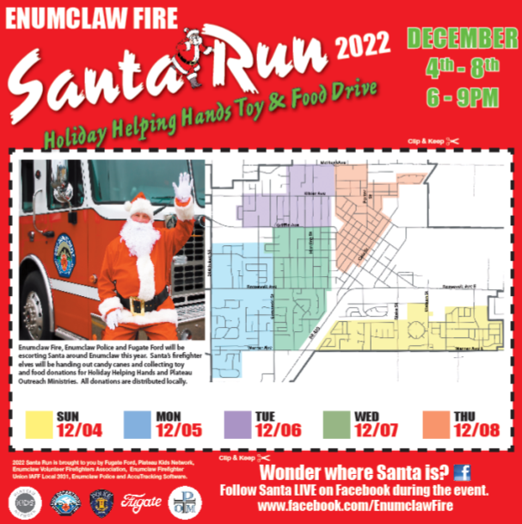


Slide 4
Call Volume

Slide 5
Call Volume Comparison

Slide 6
Call Volume Comparison

Slide 7
Call Volume Comparison

Slide 8
Call Volume Comparison
2018 Average/Month = 36
2019 Average/Month = 35
2020 Average/Month = 34
2021 Average/Month = 42
2022 Average/Month = 42

Slide 9
2018 Total Ambulance Transports = 998
2019 Total Ambulance Transports = 1,013
2020 Total Ambulance Transports = 841
2021 Total Ambulance Transports = 933
2022 Projected Ambulance Transports = 1,072
Transports

Slide 10
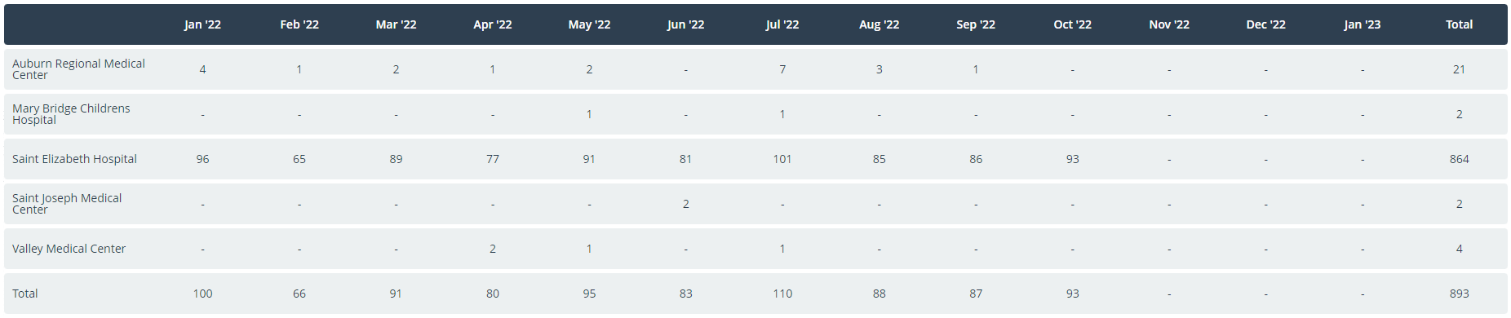
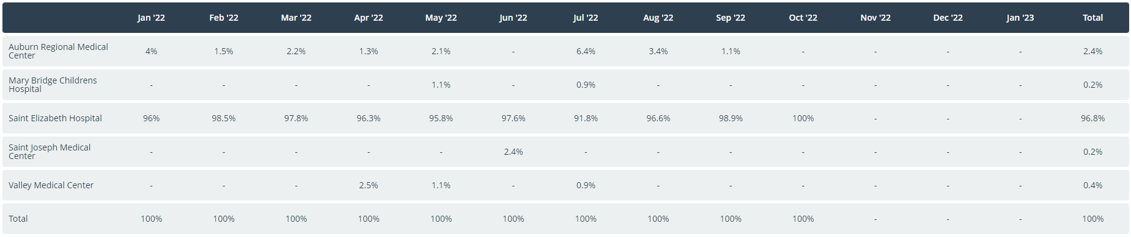
Transports by Destination

Slide 11
Deputy Chief Report

Slide 12
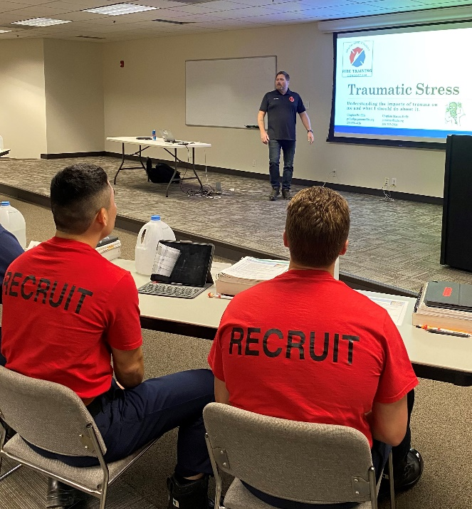
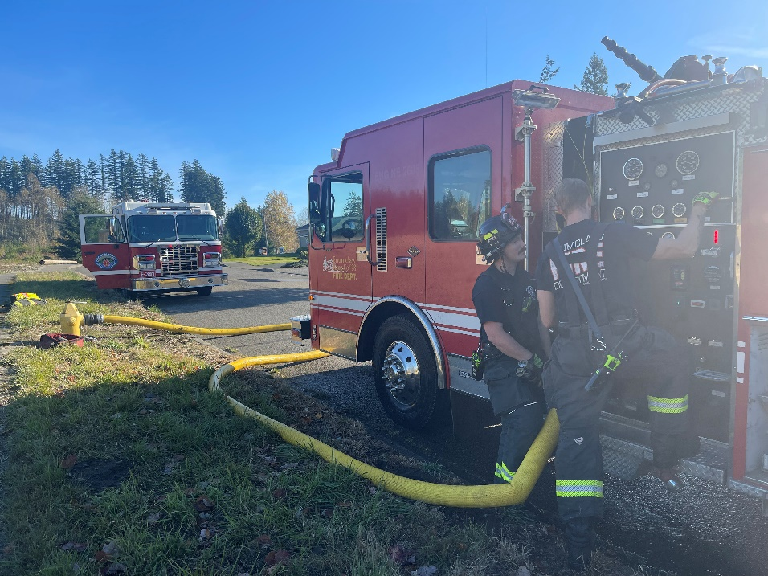
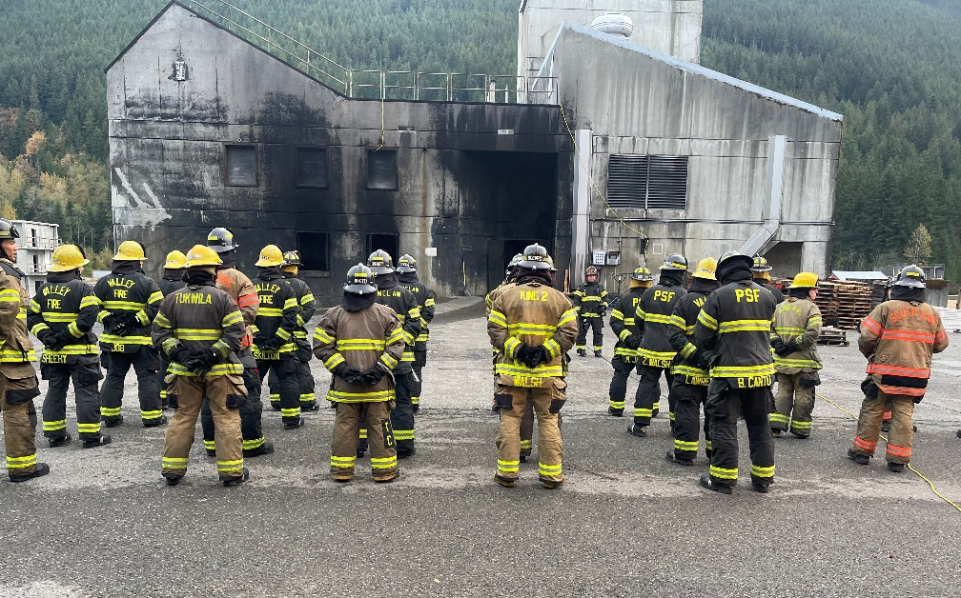
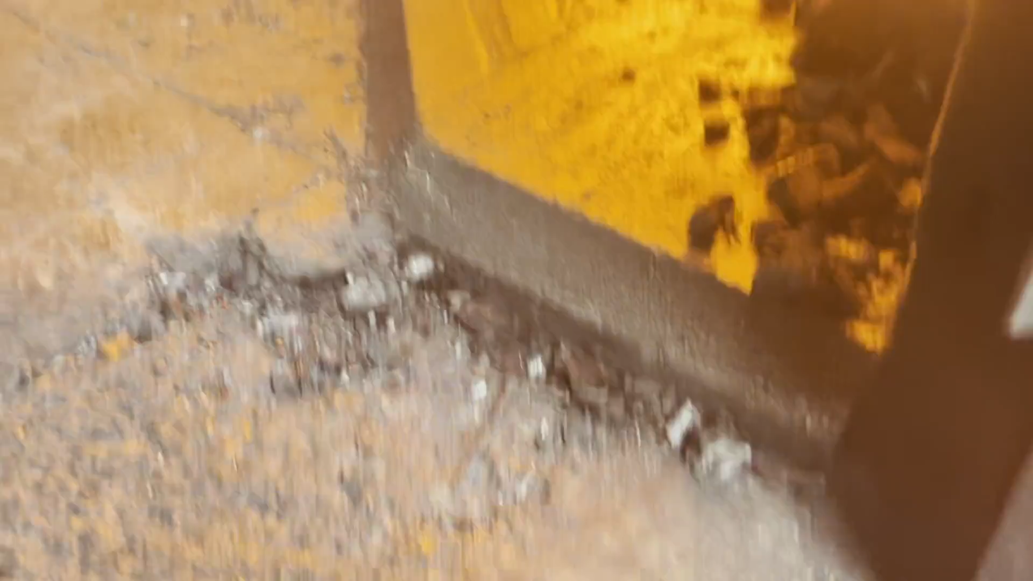
TRAINING

Slide 13
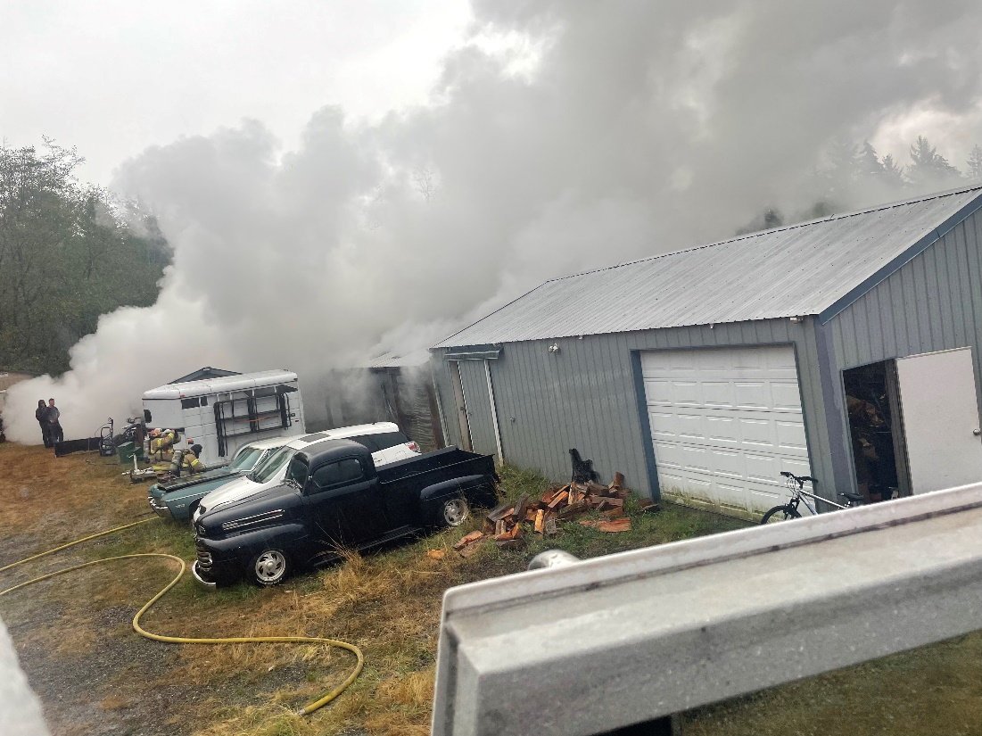
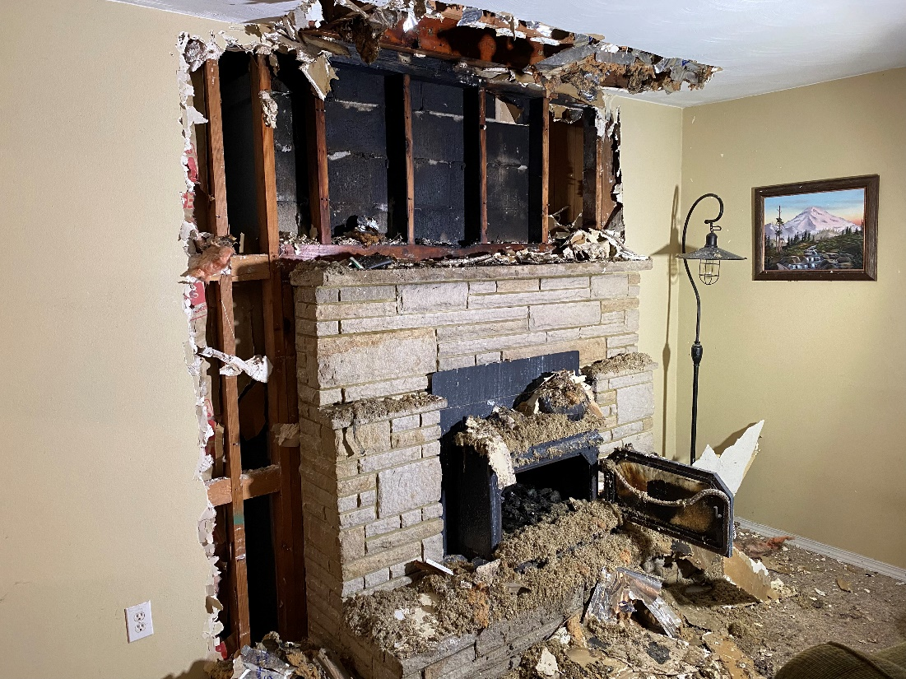
NOTEWORTHY CALLS

Slide 14
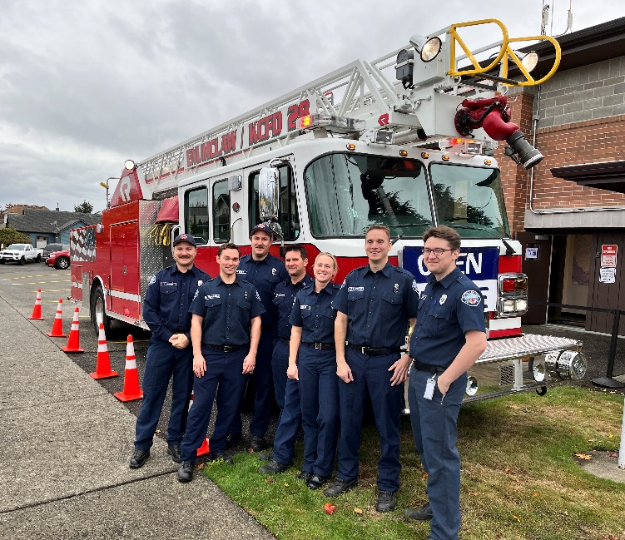
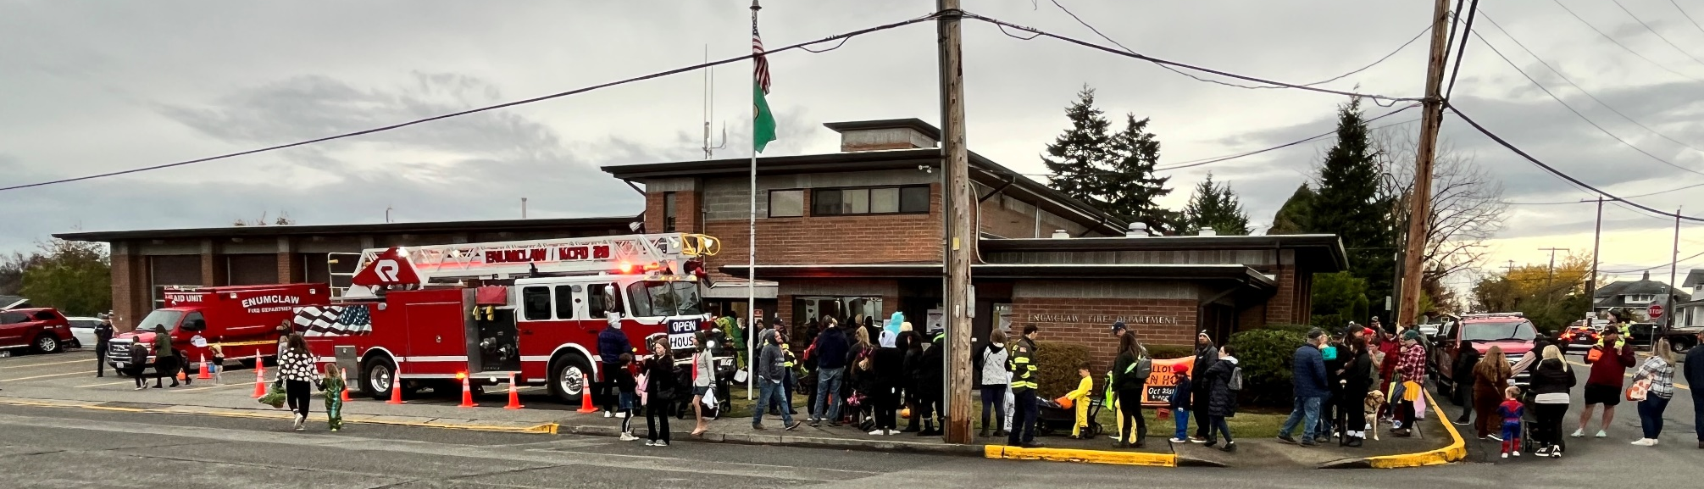
COMMUNITY INVOLVEMENT

Slide 15
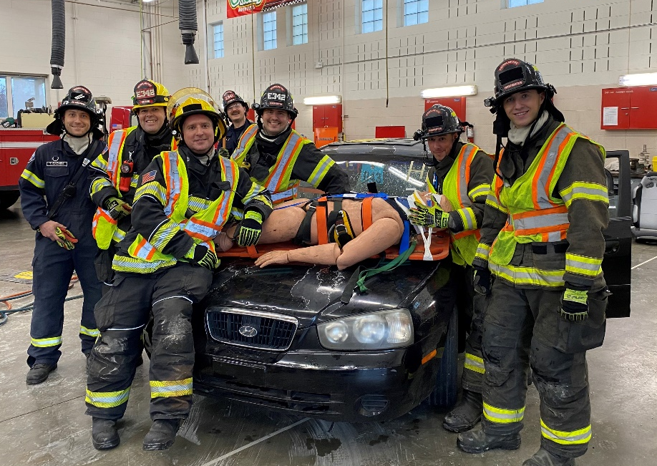
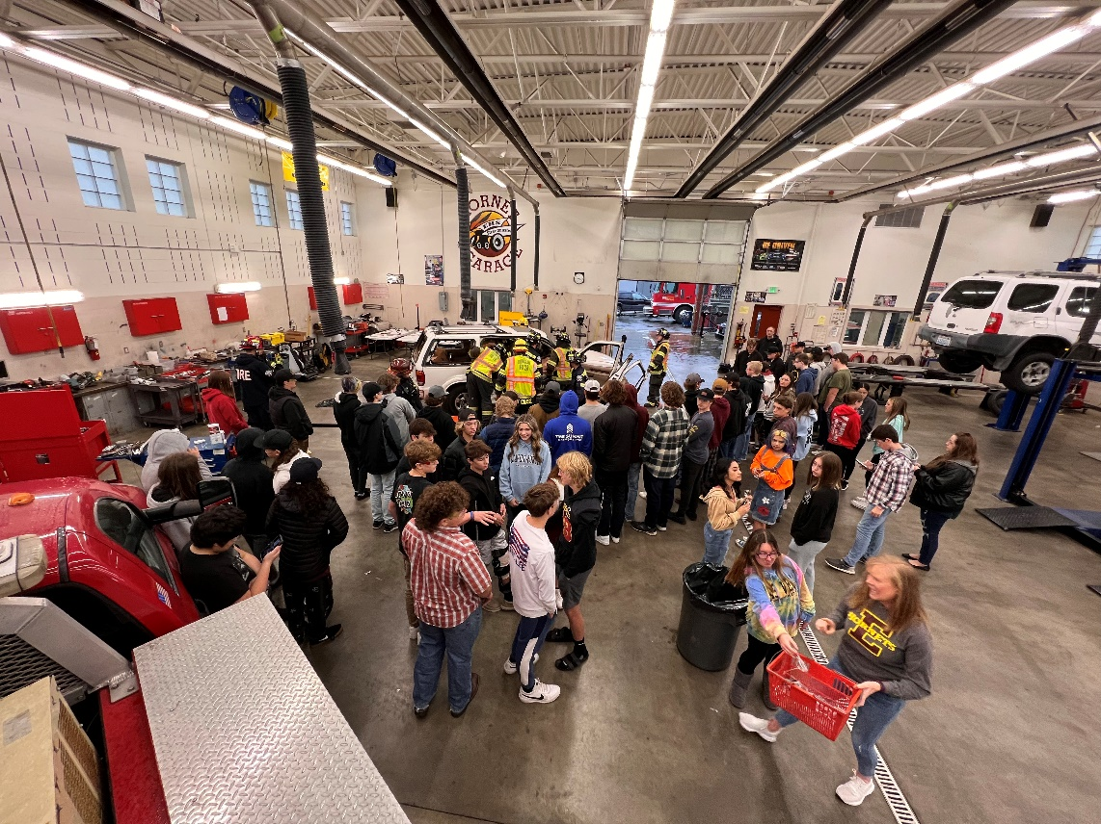
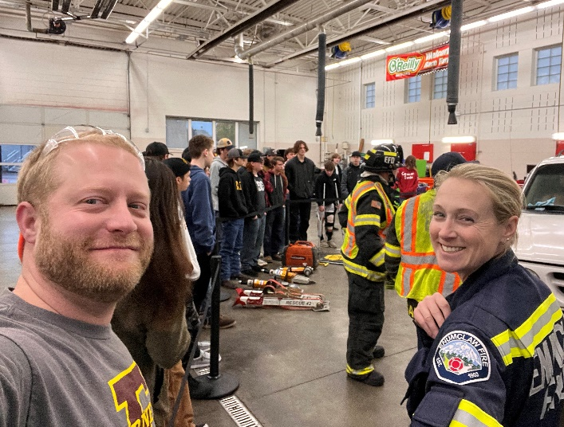
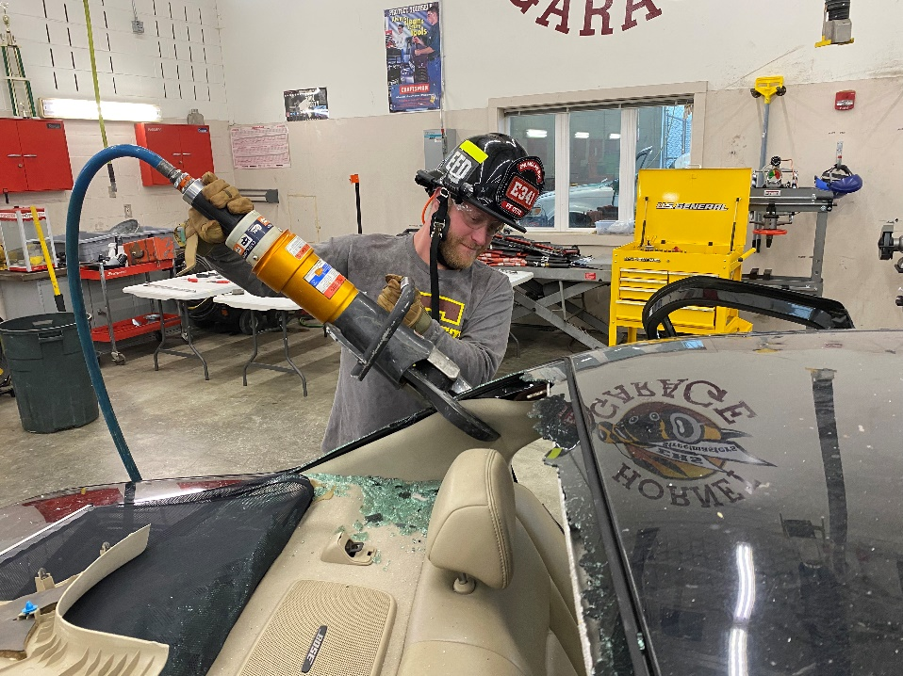
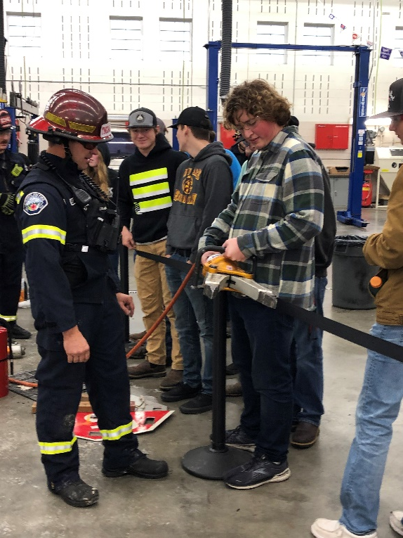
COMMUNITY INVOLVEMENT

Slide 16
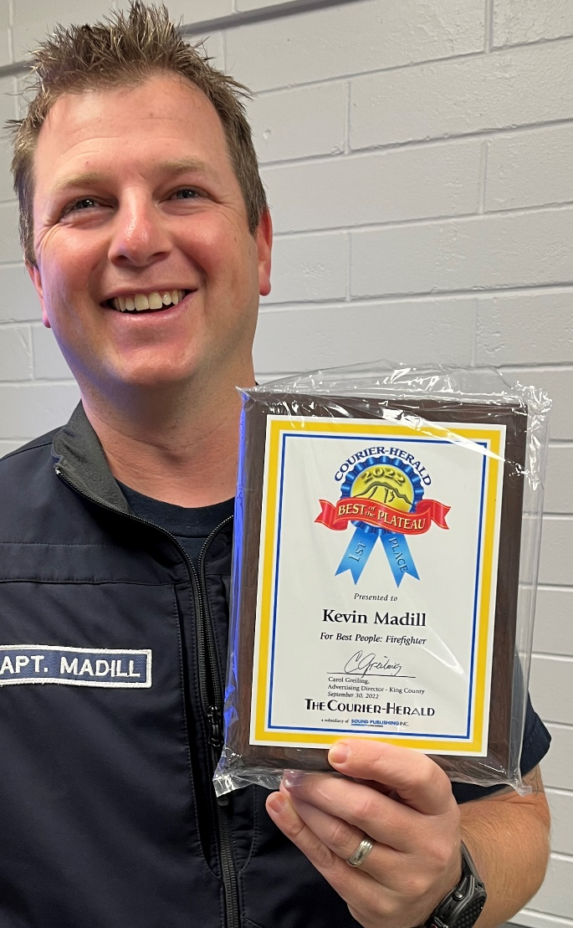
RECOGNITION

