Slide 1


Chief’s Report
Enumclaw Fire Department
12-14-2022

Slide 2
Follow up/Information
Commercial space lease was approved to form by Attorney Snure and has been signed by both parties
FD CARES ILA was approved by the PSRFA Governance Board on 12/7
Working to implement “Treat and Refer” program at EFD in conjunction with FD CARES
TCA station analysis kick-off meeting occurred on 12/13
Candidate who was slated to begin February academy accepted position with Seattle Fire Department
Conditional offer made to another candidate for the February Academy
SKCFTC ILA ‘23-’25 was approved by Admin Board and sent to all parties to sign

Slide 3
Call Volume

Slide 4
Call Volume Comparison

Slide 5
Call Volume Comparison

Slide 6
Call Volume Comparison

Slide 7
Call Volume Comparison
2018 Average/Month = 36
2019 Average/Month = 35
2020 Average/Month = 34
2021 Average/Month = 42
2022 Average/Month = 43

Slide 8
2018 Total Ambulance Transports = 998
2019 Total Ambulance Transports = 1,013
2020 Total Ambulance Transports = 841
2021 Total Ambulance Transports = 933
2022 Projected Ambulance Transports = 1,080
Transports

Slide 9
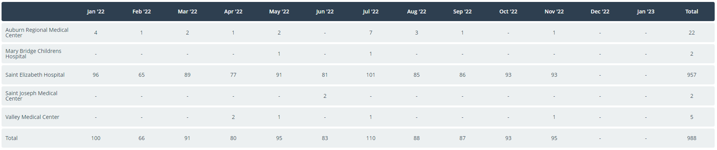
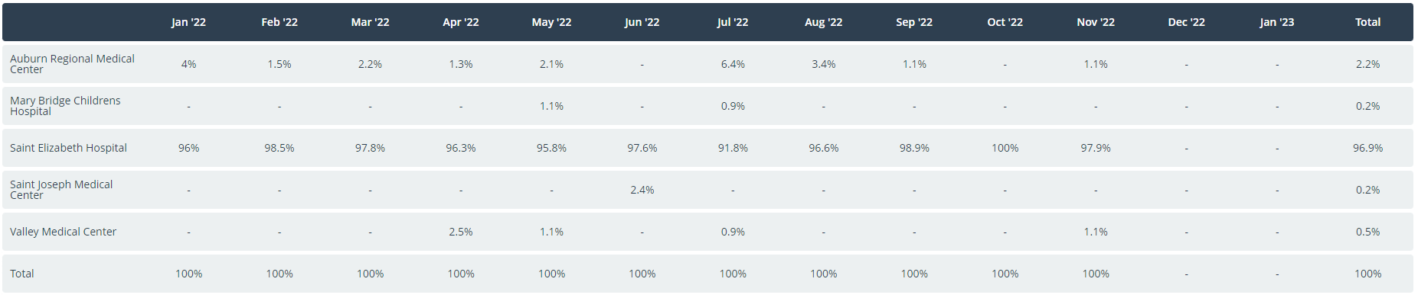
Transports by Destination

Slide 10
Deputy Chief Update
RECOGNITION
NOTEWORTHY CALLS
TRAINING
COMMUNITY INVOLVEMENT

Slide 11
RECOGNITION
Community member appreciation for PFF Muncaster and PFF Oake.
  Appreciation for their service during an Aid call.
Our four recruits are nearing the end of the Fire Academy, and all are doing a great job.

Slide 12
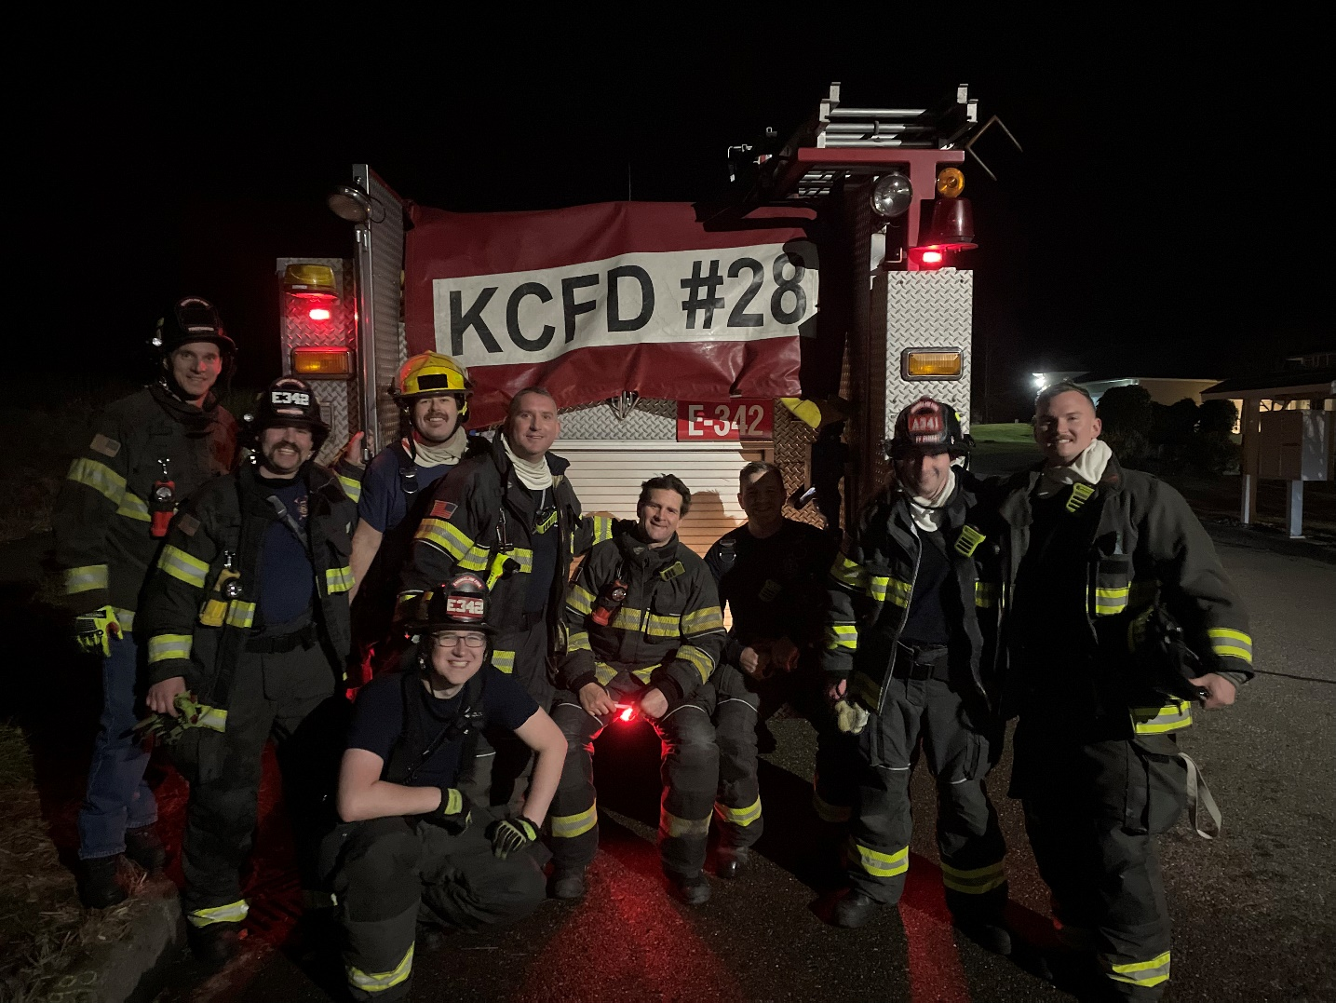
TRAINING
All the shifts are working hard to finish up all assigned training before the end of the year.
  This includes night suppression hose drills
Initial Swiftwater Technician training

Slide 13
NOTEWORTHY CALLS
There were many weather-related calls during a recent windstorm:
  Residential Fire
  Down powerlines
  Brush Fires

Slide 14
COMMUNITY INVOLVEMENT
SANTA RUN - HOLIDAY HELPING HANDS TOY AND FOOD DRIVE:
  Main organizer and lead for this event is Firefighter Maryn Otto
    Thank you to the many people who helped to make this happen
      # of people from the Fire Department
      Fugate Ford
      Enumclaw Police Department
      Many community volunteers
READING IN THE CLASSROOM

Slide 15
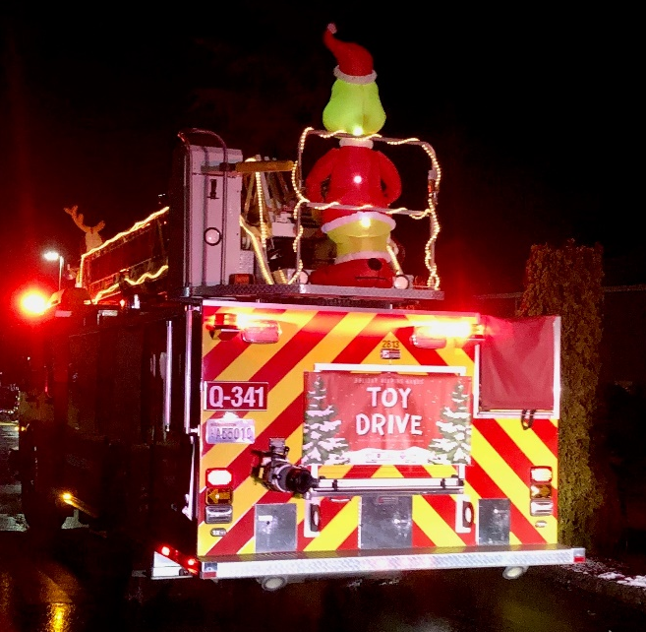
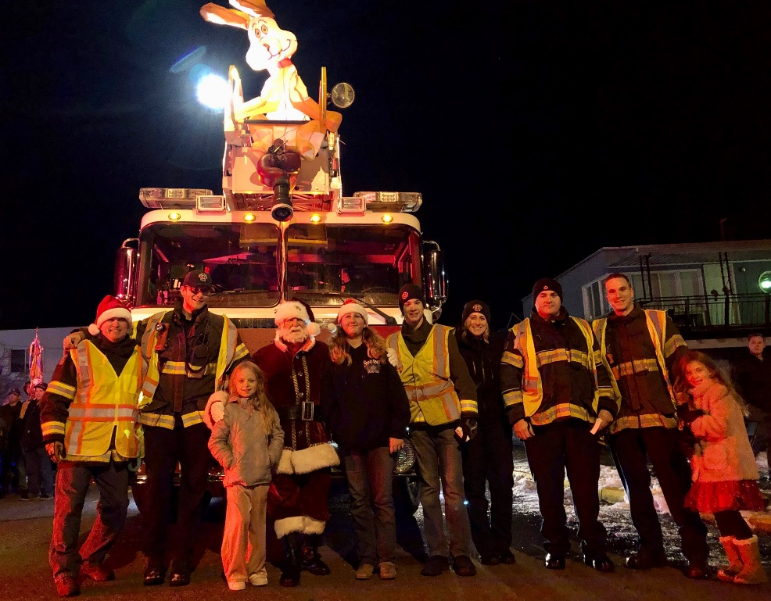
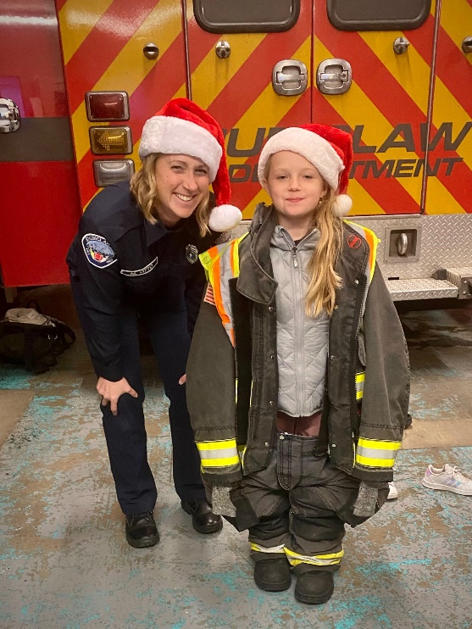
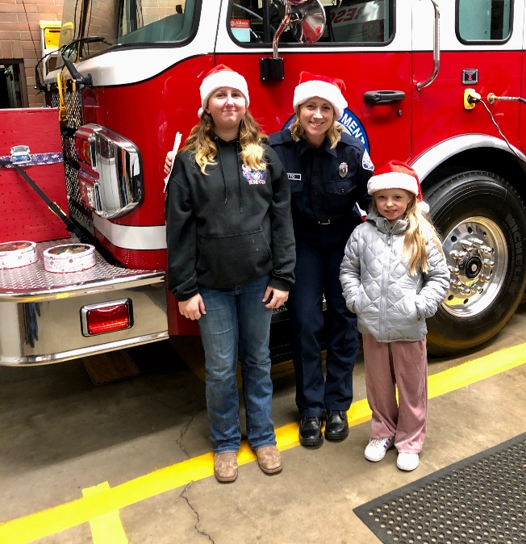
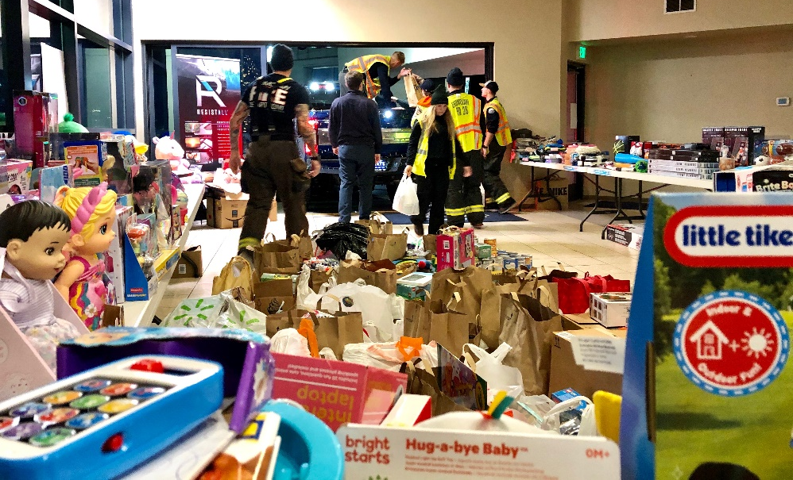
COMMUNITY INVOLVEMENT

Slide 16
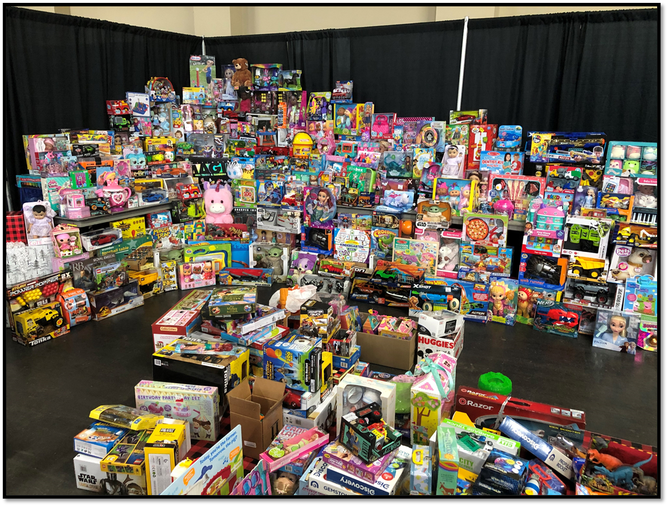
COMMUNITY INVOLVEMENT

Slide 17
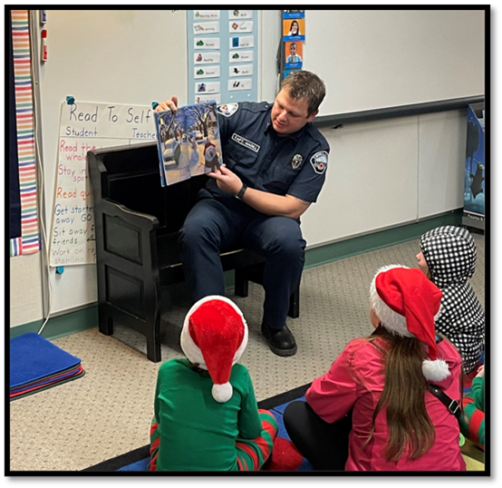
COMMUNITY INVOLVEMENT

